Slide 1
Digital Product Innovation in the Public Service
Inclusive Design
Notes:
Original version presented by Heidi Leckenby to a CSI Labs Lunch and Lab.

Slide 2
Just Quickly …
Inclusive Design vs Accessibility
Notes:
Heidi

Slide 3
Overview
Look at statistics/who’s who at the zoo
Understand barriers
Standards, law, why
How
Scope and scale of the issue for this IMB
Demonstrations
A whole bunch of questions and chatter
Notes:
Political correctness traps. No offense intended.

Slide 4
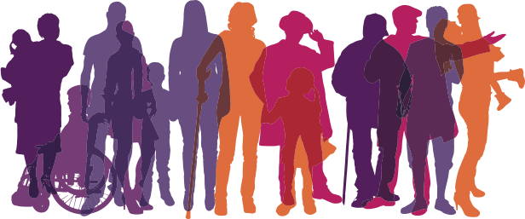
Statistically Speaking
2011 – 3.7 million British Columbians self identified as a person with a disability (15%)
Seniors represent 17.5% of the population of which 33% are registered PWDs
Notes:
Many persons with disabilities are educated, work and are members of society.
To qualify for PWD, applicants must:
• be at least 18 years of age
• have a severe mental or physical impairment that, in a medical doctor’s opinion, will likely continue for at least two or more years.
US identifies approximately 25% of its population.

Slide 5
but
Notes:
We all know that being registered doesn’t actually provide us with true numbers
We have “hidden” members of society that aren’t registered.
Could be
Slow incremental physical or mental condition
Sudden physical or mental condition
Borderline and don’t qualify for PWD
So let us understand what we mean by providing accessible services …

Slide 6

Disability Barriers
Cognitive – traumatic brain injury, autism, learning disorder, down syndrome, dementia
Motor – traumatic injury, congenital disease
Visual – legally blind, colour-blindness
Auditory – conductive hearing loss, neural hearing loss, high/low tone deafness
Seizures – vestibular disorders
Question:
What do you think are the most prevalent disabilities?
Notes:
These are PWD recognized conditions, which generally cause an impact to daily activity for more than a 2 year period.
Crowd question … shout out what you think are the most prevalent disabilities?
Note:
There is a higher prevalence of users with learning/reading/cognitive barriers than there are blind. In fact colour blindness and dyslexia are more common than blindness as well BUT we know how to code for screen readers.
Why do we think of blind or deaf as the most common?
Advocates … businesses, technology, it’s more “in your face”. By focusing on a particular higher profile disability we risk ignoring or even introducing other barriers.
(HEIDI: Can we refine this – I’m not sure what this is meant to convey?) [Heidi] Gav, it is just some conversation point … most designers build toward one kind of barrier group, still blocking use for others.

Slide 7
Understanding
Disability
… physical, sensory or mental long term impairment that substantially impacts interaction with daily life
Inclusive Design /Accessibility
… the flexibility to accommodate every user’s needs and preferences when interacting with products, services and environments
vs
Notes:
So here we see the sift of not focussing on disability but including everyone through accessibility.
Disabilities - Persons with disabilities include those who have long-term physical, mental, intellectual or sensory impairments which in interaction with various barriers may hinder their full and effective participation in society on an equal basis with others
Accessibility - The provision of flexibility to accommodate each user’s needs and preferences. When used in reference to persons with disabilities, any place, space, item or service, whether physical or virtual, that is easily approached, reached, entered, exited, interacted with, understood or otherwise used by persons of varying disabilities, is determined to be accessible.

Slide 8
Societal Barriers
Attitudinal – discriminatory behaviour
Systemic – processes, policies or legislation preventing individual participation
Physical – inability to gain access or participate
Informational – sensory (sight, hearing, motor) or cognitive exclusion to information and services
Technological – lack of device or platform diversity or inability to interact with assistive devices
Notes:
By looking through the accessibility lens we are not only catering for those in grey in the earlier slide through disabilities, we are catering for all users which could come from differing cultures, socioeconomic differences, location …
(HEIDI – which previous slide? [Heidi] Gav, it’s the one talking about numbers/prevalance)
Other considerations of accessibility relate to:
Socio-economic status
Persons in remote areas
Persons in differently governed environments (First Nations)
Persons that do not have access to technology or at least the very latest technology
Mostly we look here at the marginalized persons that struggle to gain access to fair services due to some kind of barrier that inhibits them from interacting as the majority do.

Slide 9
Aim of Inclusive Design (#a11y)
Provide services and information that give a person a sense of dignity, independence, integration and equal opportunity
The best thing about inclusive design … simplicity, sound design, success through improved uptake, reduced errors, reduced enquiries, inclusion
Notes:
“There is a deeply sad irony in the idea that people who are all about inclusion use a cryptic Twitter hashtag that excludes all but the elite who have been clued into what it’s supposed to mean.” [Heidi] Gav, it this a little add on you’d like to bring in?

Slide 10

What happens
Insufficient opportunity to interact
Limited ability to gain knowledge, information or access
Infringement of fundamental rights
Exclusion
Social isolation
Strain on individual and supports
Life quality deterioration
Frustration
Notes:
The simple beginnings of not being able to interact, whether through government services or labour market or social, provides barriers to an individual’s capacity to not only succeed but to survive as well.
Here we begin with “insufficient opportunity to interact” … as simple as a person wishing to swim that is in a wheel chair with moderate brain injury (cognitive delay) which causes some vision loss …
They search the internet to find a location to swim
The swimming pool websites are difficult to navigate, too much information, colour contrasting makes it difficult to figure out buttons from text, the user enlarges their screen with Zoomtext so they have difficulty navigating around the site because the important information isn’t located together, the site page loops or skips content when they try to use the keyboard to tab through the page to the search box
So they give up and call after finding a phone number on the site
Determined, they end up finding a time to go swimming, they’ve only found one location which is 30kms away from their home that provides wheelchair access to the building, an accessible washroom and a loading crane for the pool and an assisted swimming program with assistive devices.
This person will have to change busses 3 times to reach the location.

Slide 11
And here’s some more reasons why
1 … 2 … 3 … 4

Slide 12
1 …
Standards of Conduct for Public Service Employees – Human Resources Policy 09
Service to the Public
BC Public Service employees must provide service to the public in a manner that is courteous, professional, equitable, efficient, and effective. Employees must be sensitive and responsive to the changing needs, expectations, and rights of a diverse public in the proper performance of their duties.
Notes:
Anyone remember reading the standards of conduct when they started at the BCPS?
We, as public servants, have an duty to accommodate any person that interacts with government through the work we do

Slide 13
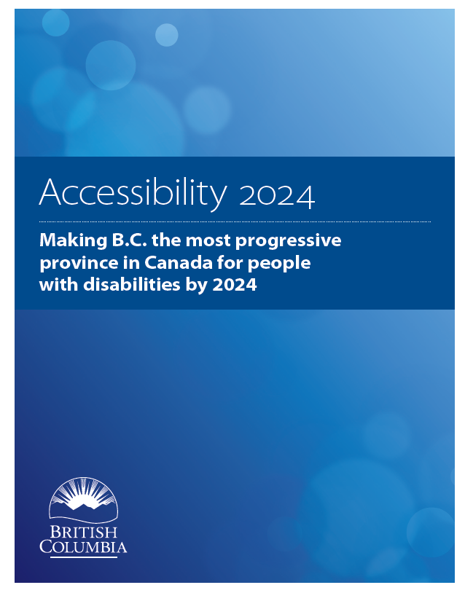
… 2 …
Accessibility 2024 ten year action plan
12 building blocks to address government’s commitment to accessibility
Notes:
Public consultation to understand the needs of disabilities in bc
Accessibility secretariat
Supports the United Nations Convention on the Rights of Persons with Disabilities
that looks at all aspects of government’s interaction with individuals addressing needs of accessibility

Slide 14
… 3 …
BC Human Rights Code 1996
Discrimination in accommodation, service and facility
8 (1) A person must not, without a bona fide and reasonable justification,
(a) deny to a person or class of persons any accommodation, service or facility customarily available to the public, or
(b) discriminate against a person or class of persons regarding any accommodation, service or facility customarily available to the public
because of the race, colour, ancestry, place of origin, religion, marital status, family status, physical or mental disability, sex, sexual orientation, gender identity or expression, or age of that person or class of persons.
Notes:
Challenge to federal websites filed by Donna Jodhan of Toronto. She is legally blind and is a sophisticated computer user. Despite being computer savvy, Jodhan was unable to access the federal government's informational and transactional services online. She sued and cited five examples of inaccessible online services, and in November 2010 the Federal Court agreed with her.

Slide 15
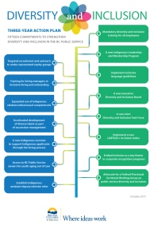
… and 4
BC Government’s Diversity & Inclusion Action Plan
Notes:
Just in the last couple months the government released its Diversity and Inclusion Action plan which lays out the foundation for how we work. Although largely catering for the internal staff membership, this helps support the need to ensure we design fairly.

Slide 16
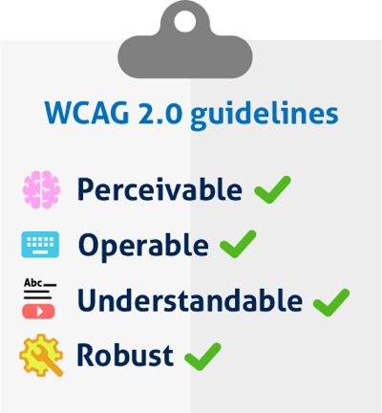
Accessibility Standards
World Wide Web Consortium (W3C)
Web Content Accessibility Guidelines (WCAG)
4 Principles
Notes:
W3C is a collaborative international group of member organizations, staff, and public
WCAG was developed by these people.
Accessibility for Ontarians with Disabilities Act (AODA) – WCAG 2.0 AA
Priority levels:
A – minimum level must be achieved
AA – is the level of WCAG 2.0 that is to be achieved
AAA – providing specialized enhancements

Slide 17
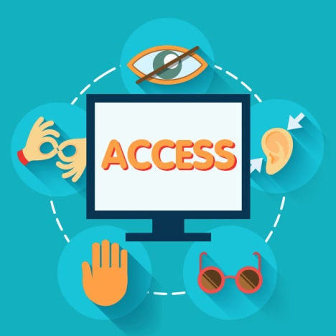
WCAG Principles
Perceivable
All elements can be perceived and used
Operable
All users can navigate and participate
Understandable
Anyone can understand how to interact
Robust
Can be used on any device, anywhere, anyhow

Slide 18

How? Design fundamentals
Overview of how to approach design …
Notes:
#1 User research AND personas for all types
#2 Create simple work flows and use plain language
#3 Design UI with colour contrasting, responsive design, easy to navigate
#4 Code for keyboard control, assistive technology, multiple devices
#5 Test/audit using the right tools and methods
#6 Test with real people from your personas
Design process – note legally providing other avenue is not sufficient. Users are entitled to use the same method as anyone else … it is by personal preference alone that the other avenue is okay.
In the background, change business rules/policy to adapt to accommodate.
Include accessibility in the development cycles of projects by:
Personas - Create personas to cover all potential users
Process - Make sure your process is available and easy to interact with for all personas
Write - Use plain language and as little wording as possible
Display/Render
Use icons (with alt text or labelling), simple flowing layouts, colour contrasting, transcripts, responsive
Code
Build into the foundations of how you code the basics to enable tab navigation and screen reader interaction

Slide 19
Personas
Create personas to accommodate persons with barriers in:
Sight – screen readers/screen enlargement
Hearing – plain language/icons/transcripts
Motor – keyboard/tab navigation
Cognitive – simple design, plain language

Slide 20
Example Personas
The following personas have several things in common … let’s look at what

Slide 21
Marty
Marty’s story…
How could we design better for Marty?
Minimal to no manual requirements (non-braille printed)
Transcribed video
Few steps
Minimal reading
Minimal to no travel requirement
Channels: IM, online chat, text, phone, conversion to Braille
Supports: white cane, guide dog, keyboard/no mouse operation, braille printer, speech recognition software, screenreader, the use of advocates
government digital experience
Notes:
So I’ve found myself receiving an eviction notice. Apparently the rent was put up and they said they sent a paper form explaining so. As much as I can use a scanner to decipher the text on paper, there was so much information on the form and it laid out so poorly the scanner couldn’t return a decipherable message to me. I am seeking an appeal through the Residential Tenancy Branch to have the decision turned around. I went onto the gov.bc.ca website using my screen reader, managed to find the information but found that the only option was a printable form to lodge a dispute, there was no phone number on the page so I had to go into the office to file my dispute. I only travel by public transit so the trip into the office took me an hour to get there as there wasn’t an office in my area, that’s 3 bus changes and a lot of asking questions of strangers to navigate my way. Yes, I can travel about on my own fairly well, however, these are generally places I frequent so the path and route are familiar to me.
Marty is legally blind and needs to access Residential Tenancy Branch Dispute resolution

Slide 22
Randy
Randy’s story…
How can we design better for randy?
Audio Transcription
Plain Language
ASL interpretation
Transcribed video/audio
Channels: IM, online chat, text, phone, TTY, ASL interpreter, Web, Brochure/Print
Supports: ASL Interpreter, Cochlear implants
government digital experience
Notes:
I have low self-esteem and have been in and out of drug addiction since my teens. I always feel left out and treated weirdly because I sound funny and miss the audible cues, it’s so difficult to explain myself time and time again that I am “just like you” – I feel, I think, I can do, but time wears you down when you have to navigate society and systems explaining your disability each and every time.
I have been wearing a hearing aid since I was 9, it helps me decipher some sounds, but I cannot hear them clearly so when I am talking with someone I read their lips. Because I have been tone deaf most of my life I find it difficult to communicate verbally as the pronunciation of words doesn’t always work out and I am quite slow. I do not make phone calls but send texts, instant messages, go online or in person to do the things I need to do.
I get high nowadays, I mean most people think I’m drunk anyway because of how I talk. I’m sick of hurting myself and want some help to get off the drugs. I decided to go to my hearing advocacy centre to find out what resources could help me. When I found out about the restrictions and all the different forms and systems to navigate my way to getting better, I just went back to using … maybe one day I’ll have the strength to get off drugs, just not today.
Randy is legally deaf and dumb and needs to access addiction services

Slide 23
Reggie
Reggie’s story…
How can we design better for Reggie?
Minimal to no travel requirements
Minimal to no manual requirements
Speech input fields
Few steps
Well laid out information
Channels: Web, phone, IM, online chat, text
Supports: mouth controller pointer, speech recognition software, electric/motorized wheelchair, use of advocates
government digital experience
Notes:
Do you know how cool it is to zoom around town in my mobility scooter? It’s something I am getting used to as my muscular dystrophy hit another milestone where my back, arm and leg muscles can no longer get me around. I have been living with my condition since I found out 10 years ago, I am constantly relearning what my abilities are or how to adapt to live life. I am still working but have adapted my work style with assistive technology (speech recognition software). I’m great at researching and doing things online, I use my Google Home to make phone calls. If I have to go out, it takes me a long time to get ready, let alone travel there, so when I am doing something online and it needs me to go into the office it’s a big deal! Recently, I applied to defer my property taxes, I can do this online, however, when it came to completing the form I found that the speech recognition software didn’t work smoothly with the online form so it took me a very long time to because I had to use pointer coordinates to complete the fields … hey I have a life to live … I don’t want to be tied up with forms!
Reggie has muscular Dystrophy and mobility barriers and needs to access Property Tax services

Slide 24
Seung
Seung’s story…
How could we design better for Seung?
Plain language
Clear, easily accessible information
Simple steps in the process
Channels: Web, IM, online chat, text, in-person
Supports: Cultural centre, family, friends
government digital experience
Notes:
I immigrated to Canada to provide better opportunities for my children. I chose B.C. because it’s a beautiful place with great weather, and a place where I want to raise a family. When I moved to Canada, we decided to start our own business based on our family restaurant back home. I was shocked to learn how different things are here in Canada. When I look for information online, I have a hard time understanding some of the information. English is not my primary language and I don’t really understand all of the requirements. I often go in-person to government offices to have things explained to me, or ask my friends at the cultural centre for help and advice. The process is very complicated, involving different kinds of government offices and I spend a lot of my time trying to understand all of the different steps. Some of my friends had also gone through this process in the past, but I learned that some things are done differently now. Hopefully I can get through these steps and start running my restaurant. I’ve already spent a lot of time and money, I really need to open my restaurant soon.
Is there anything else that comes up for you as a key take away from this story? Any personal experience with family, friends, or colleagues to share?

Slide 25
Dot
Dot’s story…
How could we design better for Dot?
Minimal clicking and typing
Ease of access to channel
High colour contrast
Few steps
Plain language
Channels: phone, in person
Supports: screen magnifier, advocates (i.e. community centre, family), video with good audio and captions
government digital experience
Notes:
I have had a fun life, and with that comes the wear and tear of age and all that goes with it. I’m as sharp as a tack but can’t open some doors due to the arthritis in my hands, my hearing is dulling and I have cataracts which makes reading very difficult. I am a volunteer and an active member of our community centre where we run bingo nights for fundraisers. Recently the application for the gaming grants went online, finding the form was difficult, which one is the right one? I enlarged my browser text as much as I could but found it difficult to make sense of the site or form, having to navigate and scroll through many pages of information I found it slow and painful with my hands and tired from my low vision. I eventually gave up and went into the centre to have someone help me fill out the correct form.
Dot is a senior who has cataracts, arthritis, and low hearing. She needs to access a gaming grant for her bingo fundraiser.

Slide 26
Dale
Dale’s story…
How can we design better for Dale?
Plain language
Simple processes
Minimal to no travel requirements
Small download file size
Application guidance – live chat?
Channels and touchpoints: in-person, phone, mail, brochure/print, web (last resort)
Supports: Industry associations, family, friends
government digital experience
Notes:
I’ve been farming for as long as I can remember. My parents and grandparents were farmers. Not surprisingly, my children have been involved with the farm as well. Going forward, I’m not sure if it’s something we’ll keep going in our family. We’ve had some really challenging years and it’s getting more and more difficult to make enough money to continue. Some of my children have pursued other types of work and I don’t blame them. I’ve recently needed to apply for a groundwater licence, something new the government has introduced in the last couple years. I only heard about it through an association I’m a member of. I understand government’s intentions around water sustainability, but it seems just like another way for government to get money from me. All of these small things add up and make it really hard for us to be successful. The application process was just brutal – I couldn’t understand the language being used, the information they required was too technical, there were so many steps, and you had to complete this all online! We don’t have the best internet around here. The nearest government office is about a six hour drive away. I’m good with farming, but I’m not into paperwork or computers. I struggle with that kind of stuff, luckily my kids were able to help me through that.
Is there anything else that comes up for you as a key take away from this story? Any personal experience with family, friends, or colleagues to share?

Slide 27
Aubrey
Aubrey’s story…
How could we design better for Aubrey?
Reduce amount of text on web pages
Clear, concise instructions
Consistent information
Avoid duplicate information
government digital experience
Notes:
I found out from my mom that my cousins are paying less for MSP than me, even though my wage is the same as theirs. So I think I can get less too. When I looked it up, there was so much to read. I’m dyslexic, so I always read everything twice. I read one page and then took a break. I often do that if I’m looking up something like this at home. I don’t want to miss anything important, so it takes a long time. I just want to get through it, get stuff figured out, but I don’t want to make a mistake. It’s a lot of information. I’ll try it first on my phone, but if the print is too small, I’ll switch to my iMac. I check everything to make sure I didn’t spell anything wrong.
Aubrey has dyslexia and needs to access Premium Assistance
We can see that the improvements suggested by this story would make the experience better for everyone

Slide 28
Common Elements
What did you pick up?
Notes:
Channel options
Simple steps
Minimal travel
Plain language
Consistency
Ease of access

Slide 29
UI Design
Easy to understand and navigate processes
Colour contrast
Use plain language and icons
Content structure – headings, lists, links, data
Page elements – semantic order, alt text, alerts, form fields, buttons

Slide 30
Coding
Provide skip to links
Inform users – alt text, alerts, popups
ARIA page zones
Responsive design
Tab order
Labels

Slide 31
Testing
Manual tab/keyboard tests
Online tests
Multiple device, platform, browser tests
Screen reader tests
Check the code
Cognitive Barrier check – process, workflow
User testing
Notes:
I don’t know how we might address automated testing.
Some work has been done on this in the last couple of years
mostly by jury rigging unit test code acquired from Google Chrome GitHub repo – but this wasn’t the intent of that
No manual or automated testing is a substitute for user test – NOT business acceptance testing (most commonly used for UAT)

Slide 32
Activity in Gov
GCPE/GDX
Auditing and advisory services
Outreach to developer networks
Continual development of guides on gov.bc.ca
Service Design project focussed on inclusive design
Accessibility Secretariat (MTIC)
Out reach and Accessibility 2024

Slide 33
Scope of Considerations
Build into project processes – start to finish
Procurement
EOI, RFP, Statements of Work, etc.
Design and development
Testing
Notes:
Whether procuring development or COTS, requirements around accessibility should be stated
Might be as short as simply requiring adherence to the published WCAG standards.
We might want to allow for the contracted resource to provide a good and strong reason if some accessibility feature can’t be met….
Thinking of a map based application here.
Our difficulty will be to test for contract fulfillment.
but if accessibility is made a part of the design process and testing occurs throughout the lifetime of the development, then we can at least have some reasonable assurance.
Agile and it’s scrum/sprint model of delivery lends itself well here. Waterfall approaches will need to ensure that accessibility is NOT an afterthought but built in throughout each sub process.
Provide current sample contract/RFP language?

Slide 34
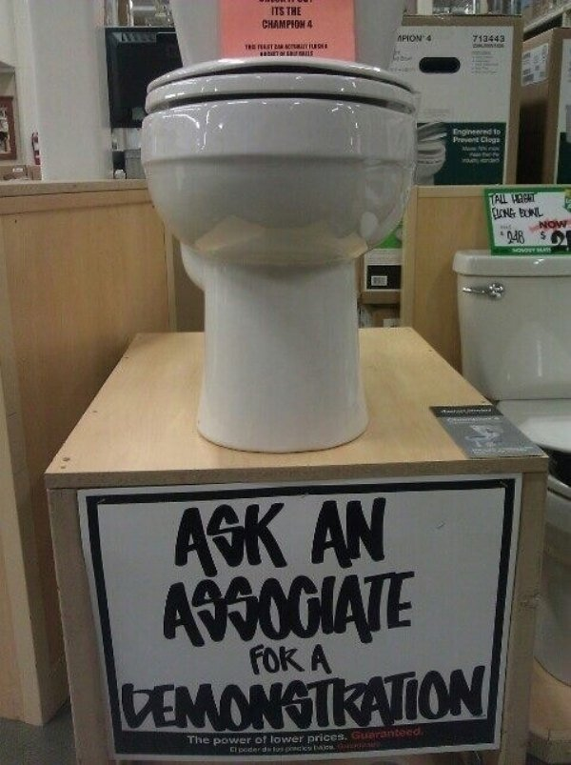
Demo Time

Slide 35
Run Screenreader Run
Trying to get software to capture a recording
Notes:
LIVE demo
WAVE:
DriveBC front page (disastrous)
DriveBC Mobile Major Events (not so bad)
NVDA:
just demo what it sounds like – any content page on the gov site.
need to show the speed at which screenreaders are actual used (90 somethings)

Slide 36
Tools
Several categories of testing tools
Online Code (WAVE, AChecker)
Online Simulators (Dyslexia and Colour Blindness)
Browser add-ons (WAVE, aXe, ChromeVox + Dev)
Actual assistive devices (JAWS, NVDA, Dragon Naturally Speaking, Braille readers)
Automation integration (AADT, Tanaguru)
People – the real deal

Slide 37
Tools - Online
Online (WAVE, AChecker)
Good for one-off checks
Won’t work for material that is secured behind firewalls and logins
Can’t check for cognitive recognition (wording, logical process)

Slide 38
Tools – Add-ons
Browser add-ons (WAVE, aXe, Chrome Tools)
Better for manual one offs
More of these available
Most are free
Most are currently best used with Chrome
Notes:
Switch to browser WAVE demo

Slide 39
Tools – Real Assistive Devices
Actual assistive devices
Most require Windows because they hook into it’s built in assistive tech libraries
Require expertise to use but can be learned enough for rudimentary testing
Notes:
JAWS (voice rendering)
Costs, but a free version has recently come available
Feature rich
Easier to use
Multiple “synths” (voices) available for a price.
NVDA NonVisual Desktop Access (voice rendering)m
Since 2007 has been increasing dramatically in popularity
Lags in technical features
Runs off many devices including thumb drives.
Primarily uses Microsoft’s built-in “synths” but hacks (most illegal) may be possible
Smart Phones!
Tricky but good in a pinch. These are in fact used for real, but the expense of the phone makes them a less used tool for those on limited budgets.

Slide 40
Tools – Automated Testing
Can incorporate into existing test runners
Must be set up specific for the problem and the project
Tanaguru, AADT
Notes:
AADT
Integrates into existing test suites and frameworks:
Nemo
NightwatchJS
Tanaguru
Tanaguru automates 167 accessibility tests (WCAG, Section 508, AccessiWeb). Evaluating a page, an entire site or a web application is reliable, intuitive and self accessible.
Scenario audit even lets you control different states of the same page.
And its fork “Asqatasun” which integrates through Jenkins Plugin and Docker image.

Slide 41

Then …
Questions and chatter
Contact Heidi Leckenby for advice, information or audits

